Slide 1
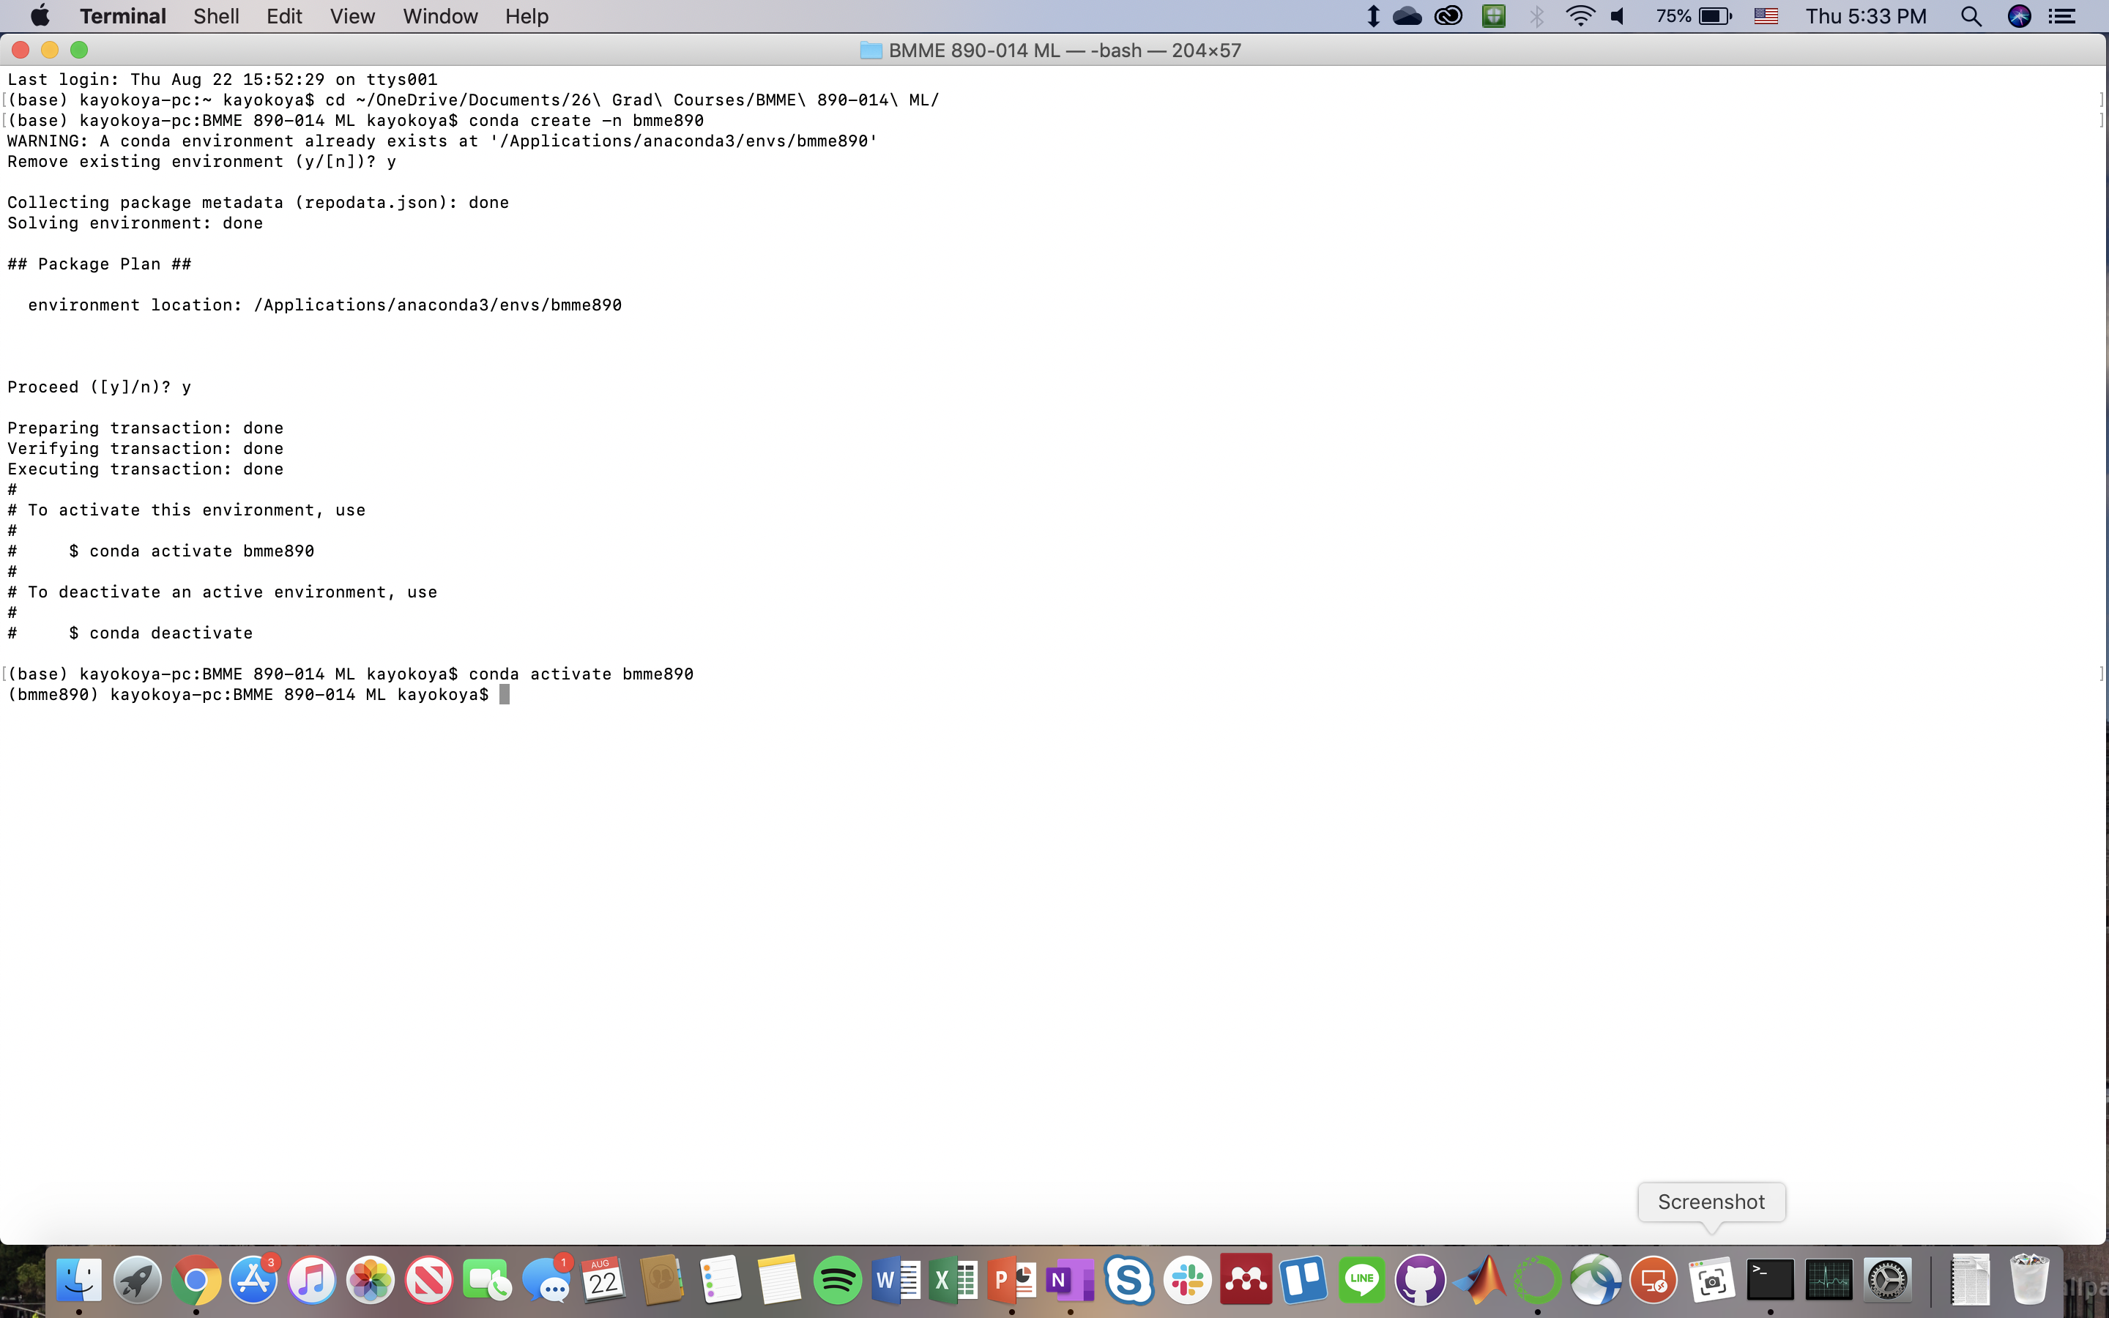
Initial environment setup

Slide 2
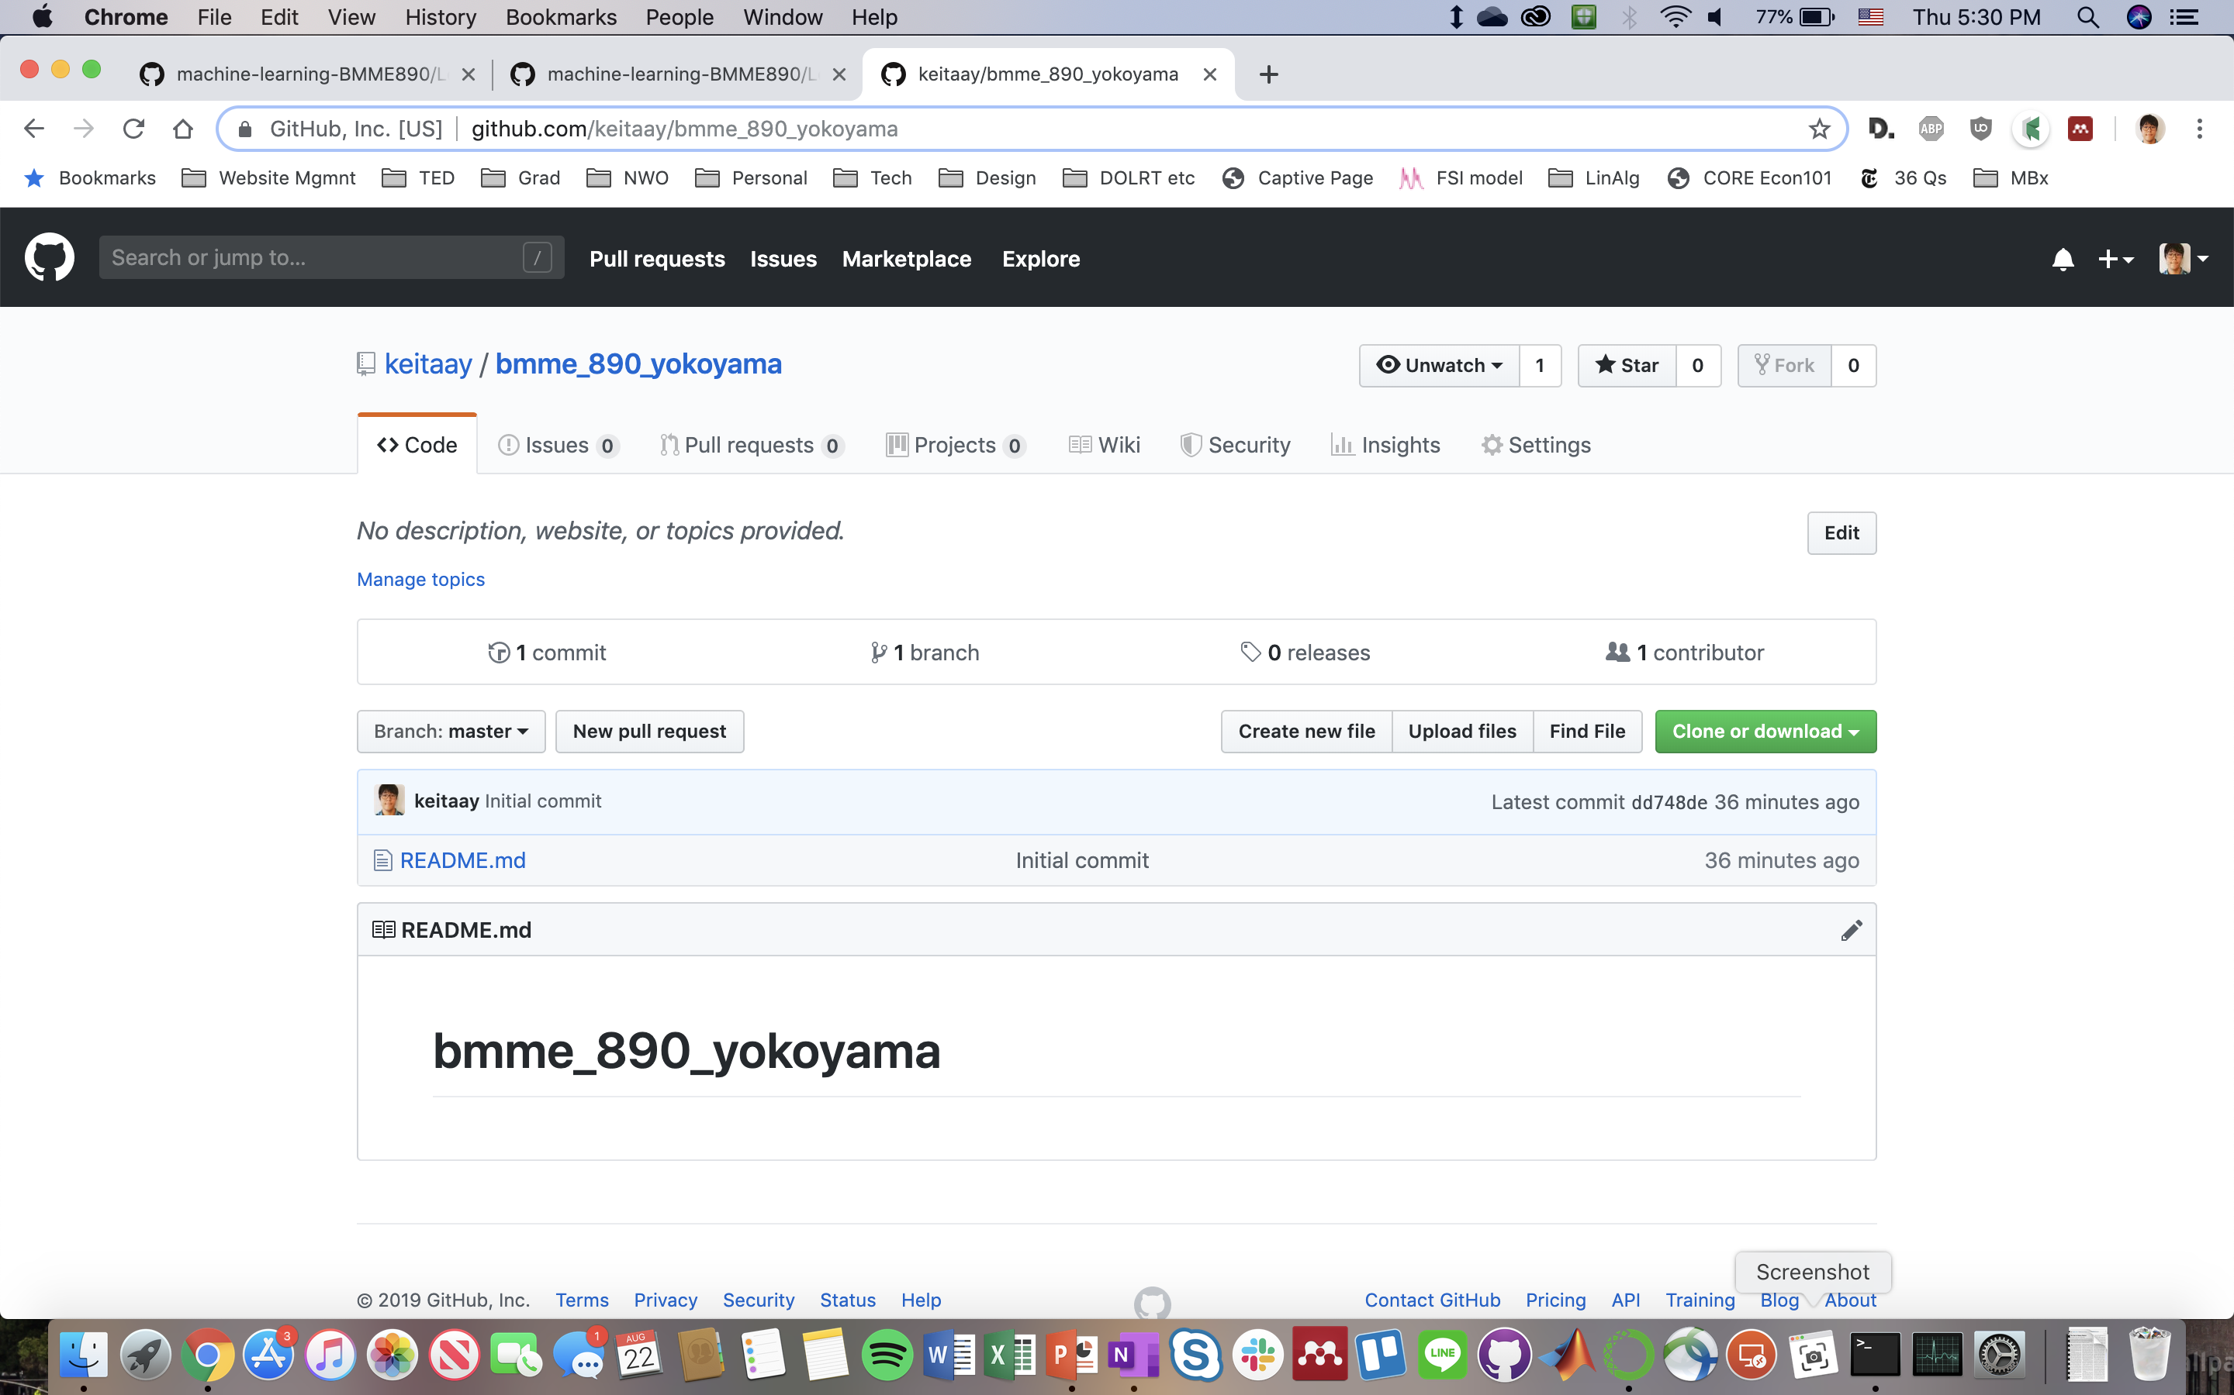
Configuring GitHub

Slide 3
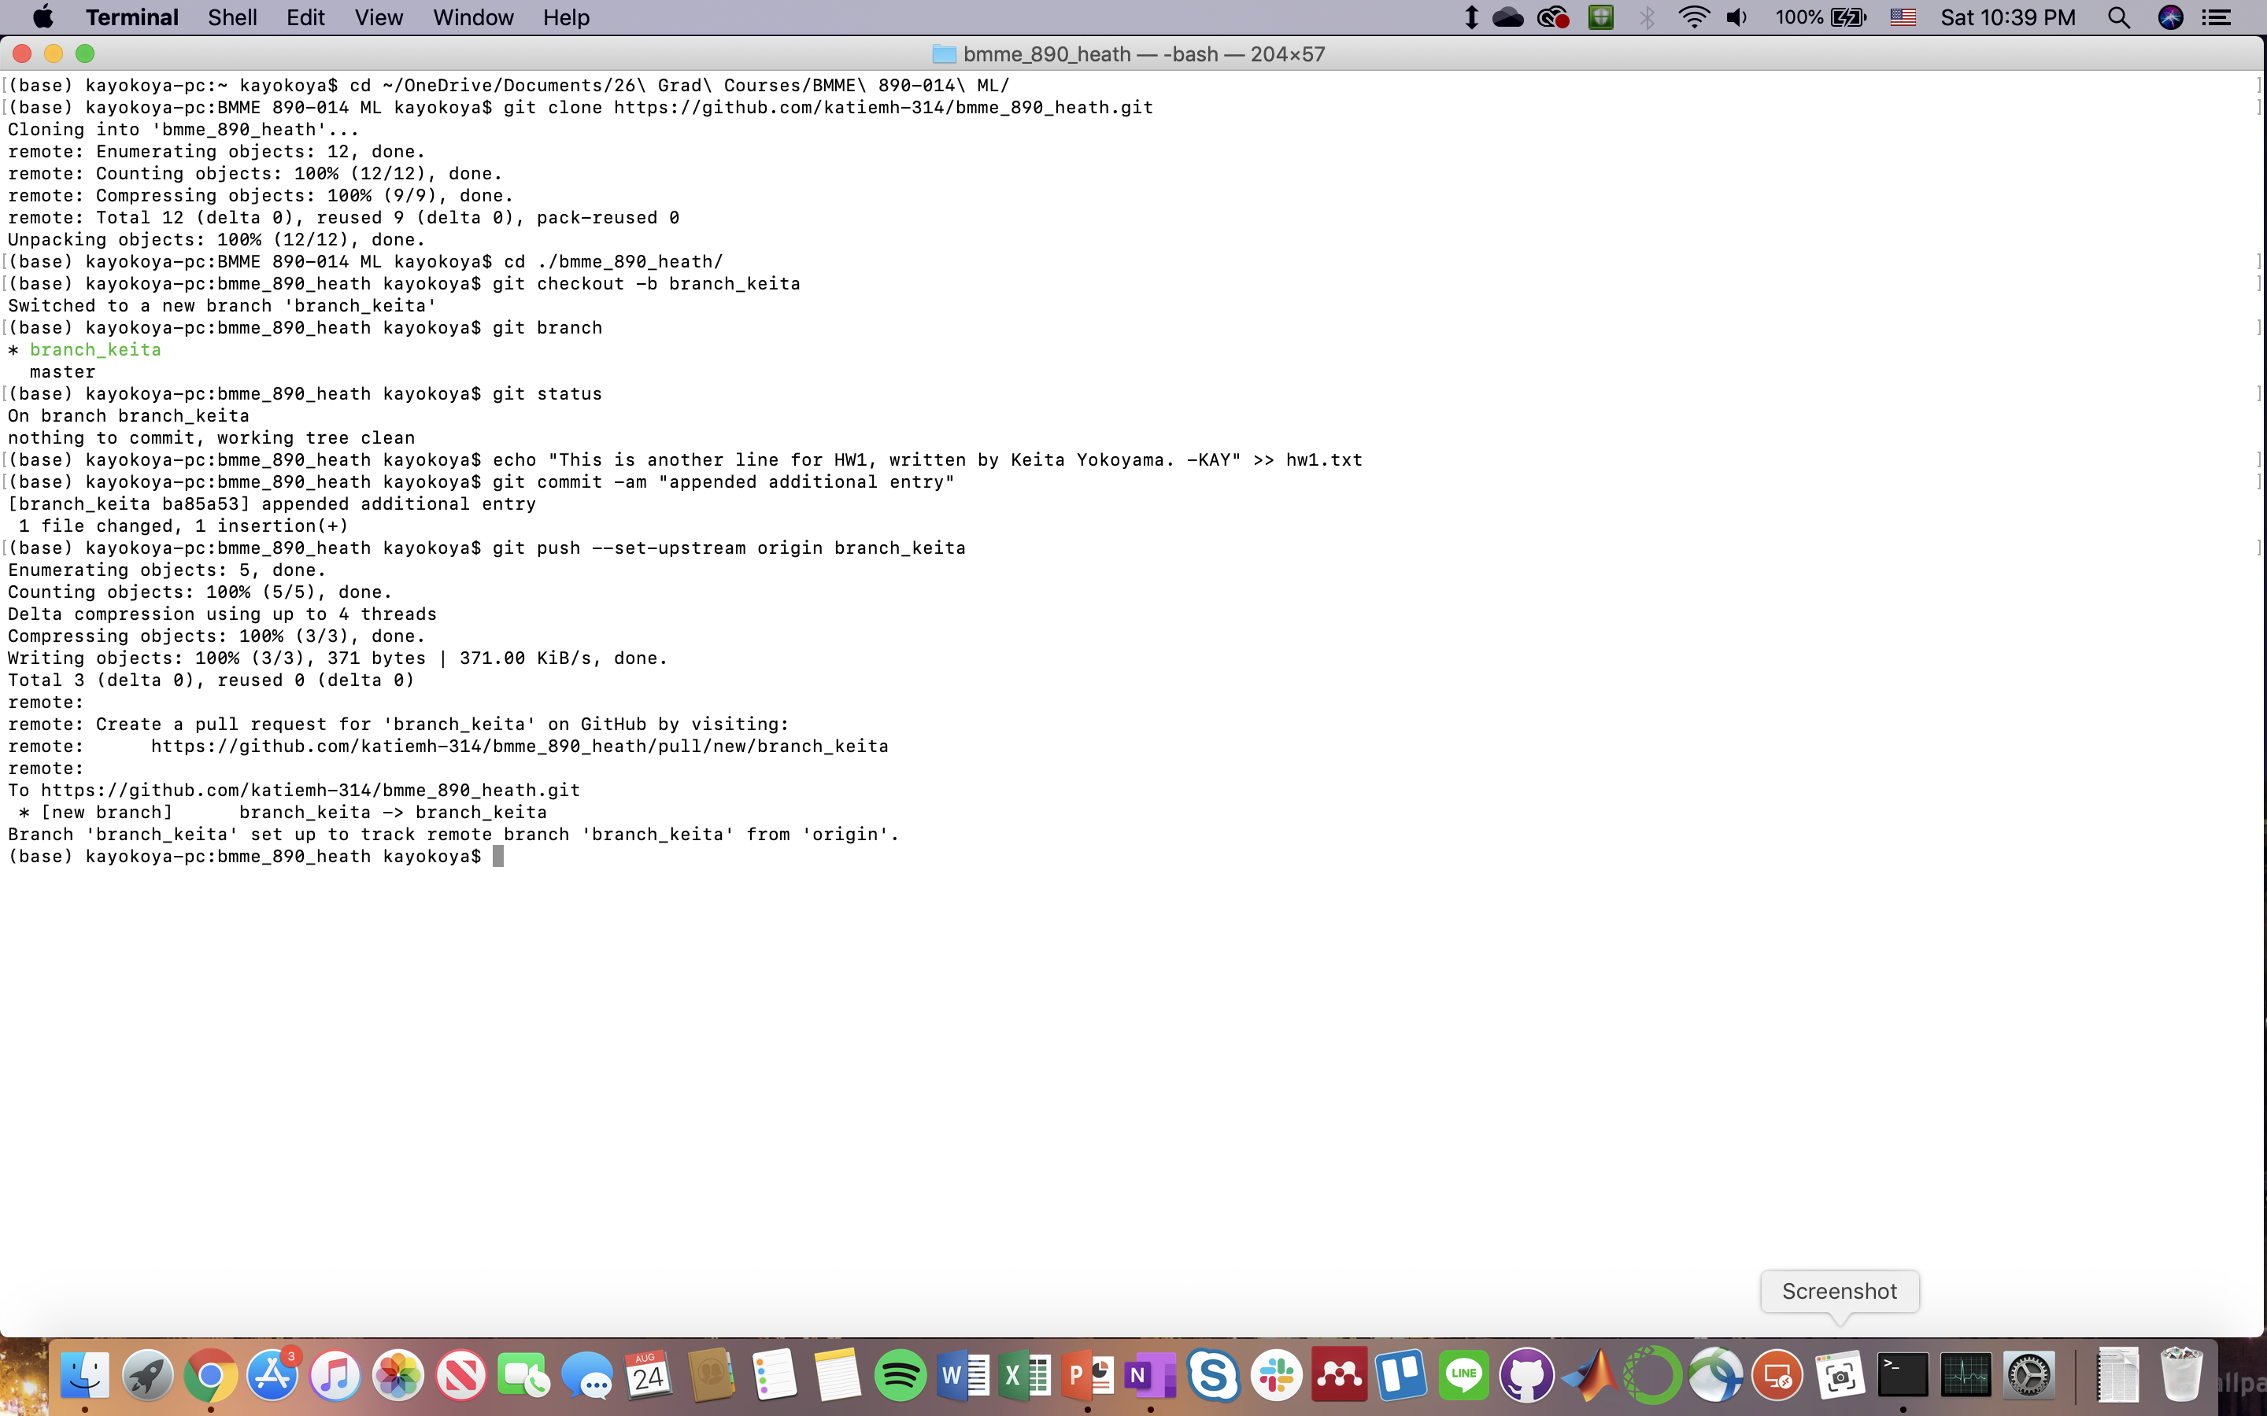
Collaboration entry: Katie Heath

Slide 4
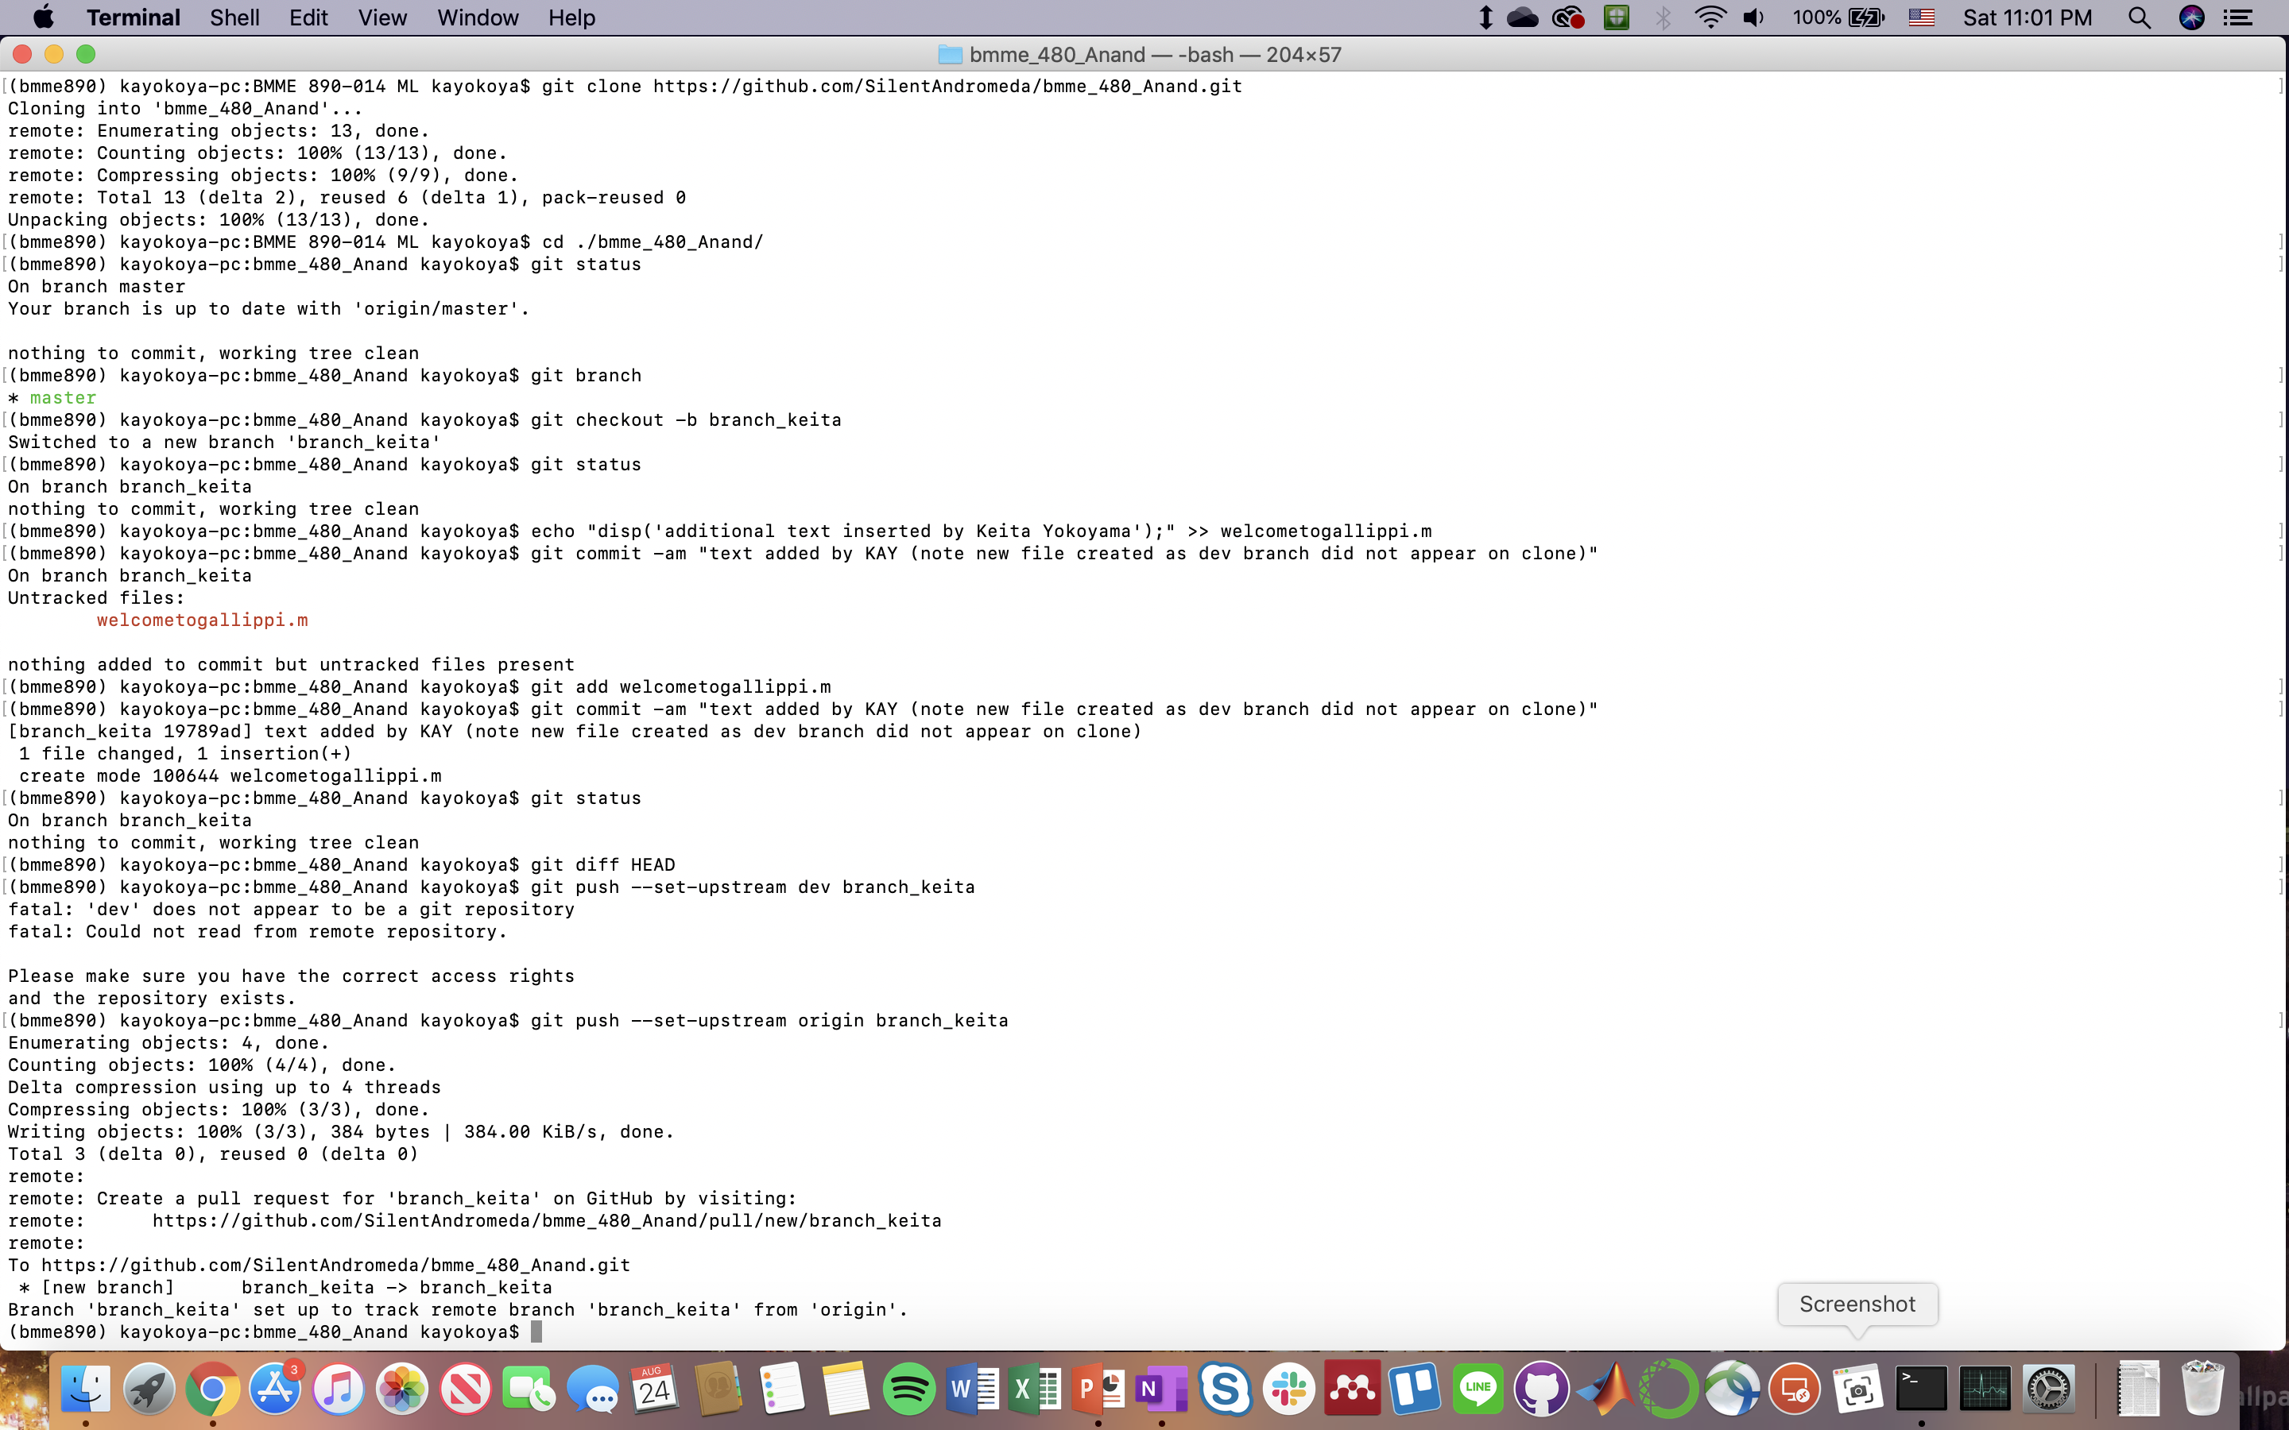
Collaboration entry: Keerthi Anand

Slide 5
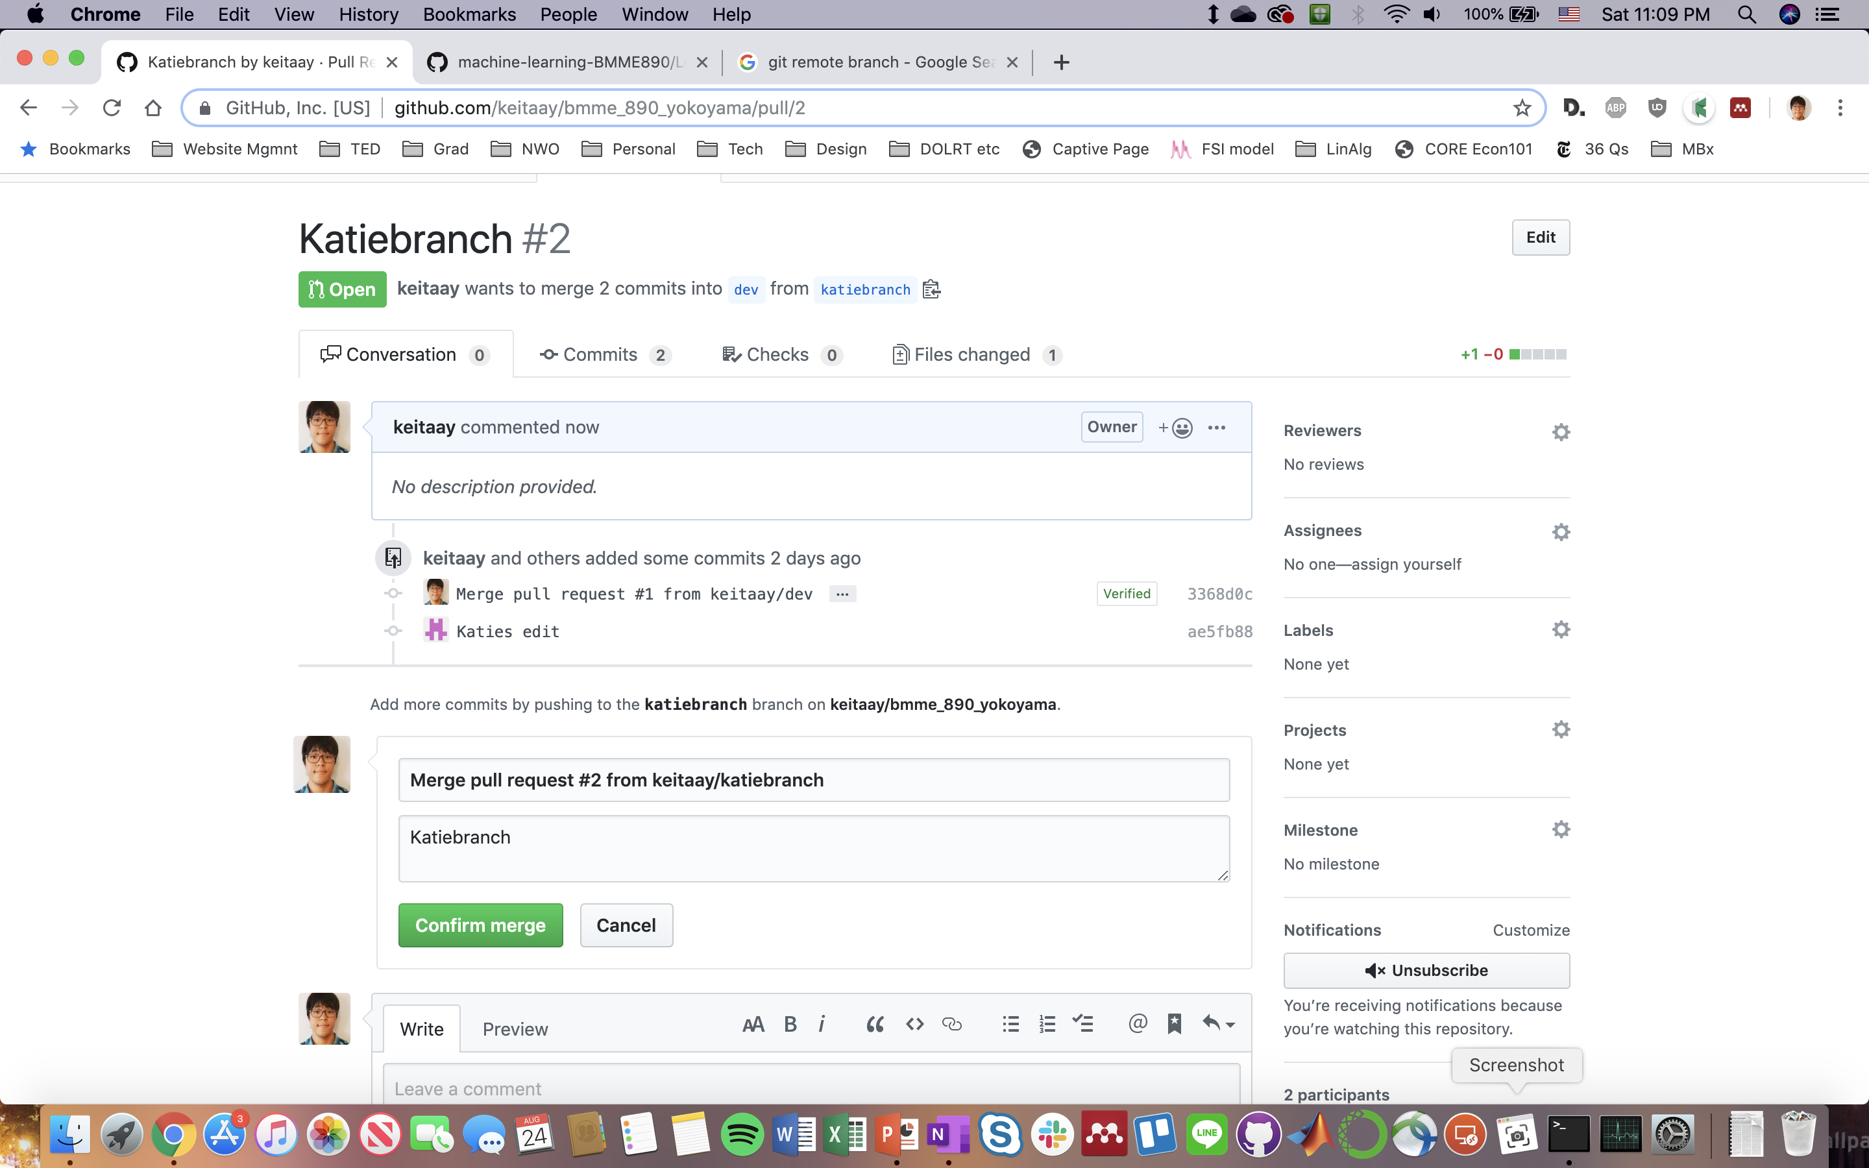
Merging entry by Katie Heath

Slide 6
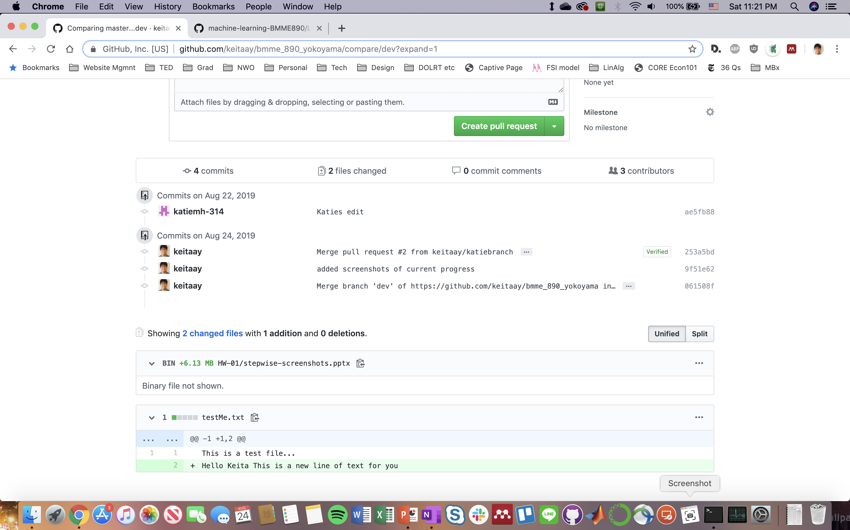
Consolidating all branches to ‘master’

